Slide 1
Abcde-fgh of autism
DSM 5
Diagnostic and therapeutic perspective
AUTISM BASICS

Slide 2
Objectives
Dsm 5 perspective
Diagnostic dilemma: flags/screening/differentials and delays
Diagnostic tools
Defining autism / denying diagnosis
Legal implications
Symptoms to guide treatment /tests

Slide 3
Why dsm 5 is important?
In 2013, autism diagnostic criteria is changed and its no longer just autism but it also includes many autism like conditions of behavior and communication , and that makes us see cases rising too.
So its now called a spectrum, means a large number of spectrum will be close to normal and independent.

Slide 4
Why dsm 5 is important?
It is the first ever international criteria that truly explains autism.. Since 2013
The sequence of events develop in the sequence of dsm criteria
So when we want to reverse changes we truly need to change the symptoms from core.. And so the sequential symptoms will start getting reduced over next few months.

Slide 5
Why dsm 5 criteria is important?
Once we know how it is happened.
We know how to reverse it.

Slide 6
A of autism
Autism core criteria of persistent deficit like
A1: social communication/interaction deficit, social initiation and reciprocation deficit
A2: non verbal communication deficit and
A3: deficit in understanding and maintaining relationships
One each of a1 a2 a3 is must

Slide 7
A1: social emotional reciprocity
A1.1 Social approach abnormal
A1.2 Abnormal back forth conversation
A1.2 Reduced sharing of interest emotion/ affect
A1.4 Failure to initiate or respond to social interactions

Slide 8
A 2: any 1 deficit in nonverbal communication
A2.1 Poor verbal / non verbal communication, poor eye contact
A2.2 Poor body language
A2.3 Deficit in gesture use or
A2.4 Total lack of facial expressions or non verbal communication

Slide 9
A3: deficit in understanding and maintaining relationships
A3.1 Deficit in developing maintaining and understanding relationships
A3.2 Difficulty adjusting behavior to suit various social context
A3.3 Difficulty in sharing imaginative play or making friends
A3.4 Absence of interest in peers

Slide 10
B of autism: any 2
Behavioral patterns..
B1 Repititive
B2 Fixed/rigid
B3 Object fascinations
B4 Sensory issues

Slide 11
B1: stereotyped or repititve motor movements
B1.1 Use of objects
B2.2 Simple motor stereotypes
B2.3 Lining up toys
B2.4 Flipping objects
B2.5 Echolalia
B2.7 Idiosynchratic phrases

Slide 12
B2: sameness / rigidness/ inflexibility/ rituality verbal or non verbal
B2.1 Extreme distress at small changes
B2.2 Difficulty with change or transition
B2.3 Rigid thinking pattern
B2.4 Greeting rituals
B2.6 Need to take same route
B2.7 Eat same food every day

Slide 13
B3: restricted fixated interest of abnormal intensity / focus
B3.1 Strong attachment / preoccupation with unusual objects
B3.2 Excessive circumscribed or perservative interests

Slide 14
B4: hyper or hypo reactivity to sensory input or unusual interest in sensory aspects around
B4.1 Apparent indifferrence to pain and temperature
B4.2 Adverse response to sound or texture
B4.3 Excessive smelling or touching of objects
B4.5 Visual fascination with light or movement

Slide 15
C of autism: condition of age
Condition for definition is that symptom onset should be before 6 years of age, previously it was five years of age; that was making many asd cases to be wrongly diagnosed as adhd after age 3 years.

Slide 16
D of autism: disability significance
Disability in autism should be clinically significant and relevant to affect education and occupation
Meaning if we educate/enable an autism kid and enable them to do better, the kid can be close to mainstream.

Slide 17
E of autism
Exclusion of other diseases explaining autism features in the child is compulsory.
If any symptoms are better explained by other diseases, one should refrain from calling it as autism, and it may have different way to manage too.

Slide 18
F of autism
Frequent close follow up management in every child with autism label is important along with early active interventional therapy..
With a follow up plan with a follow up diary to be charted weekly without spending more than 5 min
No change in hundred days with any plan should make one change the experts involved.

Slide 19
G of autism
Goals are most important
Simple achievable frequent modifiable
Definite 3 to 5 goals
To be planned in steps each month
And work towards it
They will be met with hardwork, keep target 100 days.
Not met, don’t give up.. Modify goals, work hard, change experts

Slide 20
H of autism: hope
Hope takes us forward
Each goal puts you thro hopes
See the change, record the change, believe the change
Hope for the next best
Ask for more

Slide 21
Intermittent: indigestion, irritability, constipation
And we do see often

Slide 23
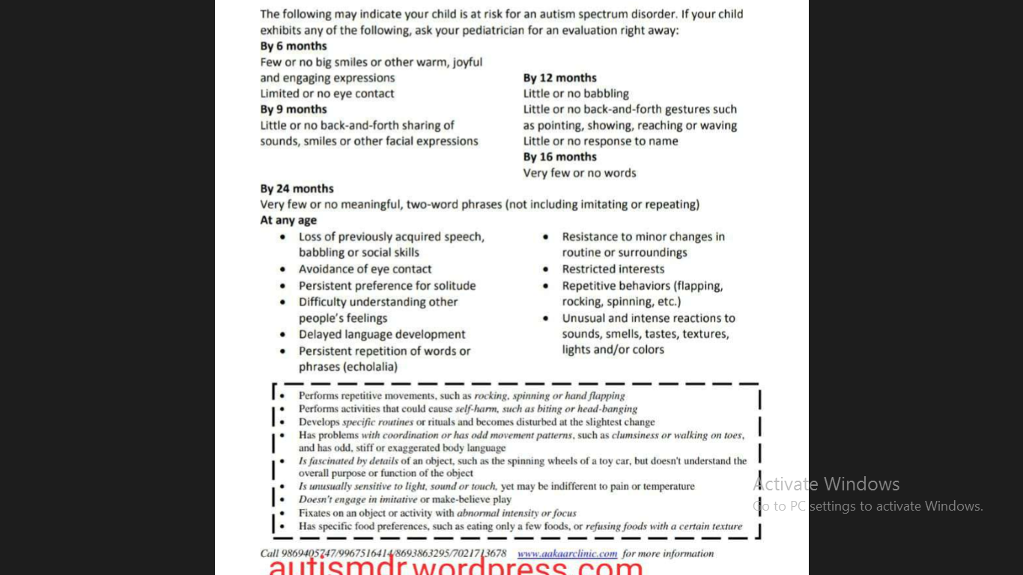
Early detection red flags

Slide 24
Diagnostic tools
Detailed neuropediatric and developmental assessment
Noting clinical markers towards aetiology delay or differential diagnosis
Multidisciplinary assessment
DSM IV – ISAA CARS INCLEN, TABC
DSM V – INCLEN Modified, 3Di, ADOS2, DISCO 11
Diagnosis is purely clinical based on questionaires and ruling out other diagnoses
HIGH SENSITIVITY OF DIAGNOSIS IS IMPORTANT TO START EARLY INTERVENTIONS.

Slide 25
Genetic /metabolic syndromes
10% OF TOTAL AUTISM CASES ARE GENETIC
3% ARE FRAGILE X
A WIDE UNEXPLORED SPECTRUM

Slide 26
Autism: < 3 year age
EVOLVING AUTISM
AS OFTEN THE SYMPTOM, COMPLEX IS NOT FULLY ELICITABLE AS PER QUESTIONARES, MANY EXPERTS REFRAIN FROM LABELLING AS AUTISM.

Slide 27
Legally how does it differ
IN INDIA, legal diagnosis is only by ISAA.
Overdiagnosis has legal implications due to sufferings parents go through.
So, always better diagnose as “suspected spectrum disorder, pending exclusion of other diagnoses”

Slide 28
Its important to know whats not autism
E

