Slide 1
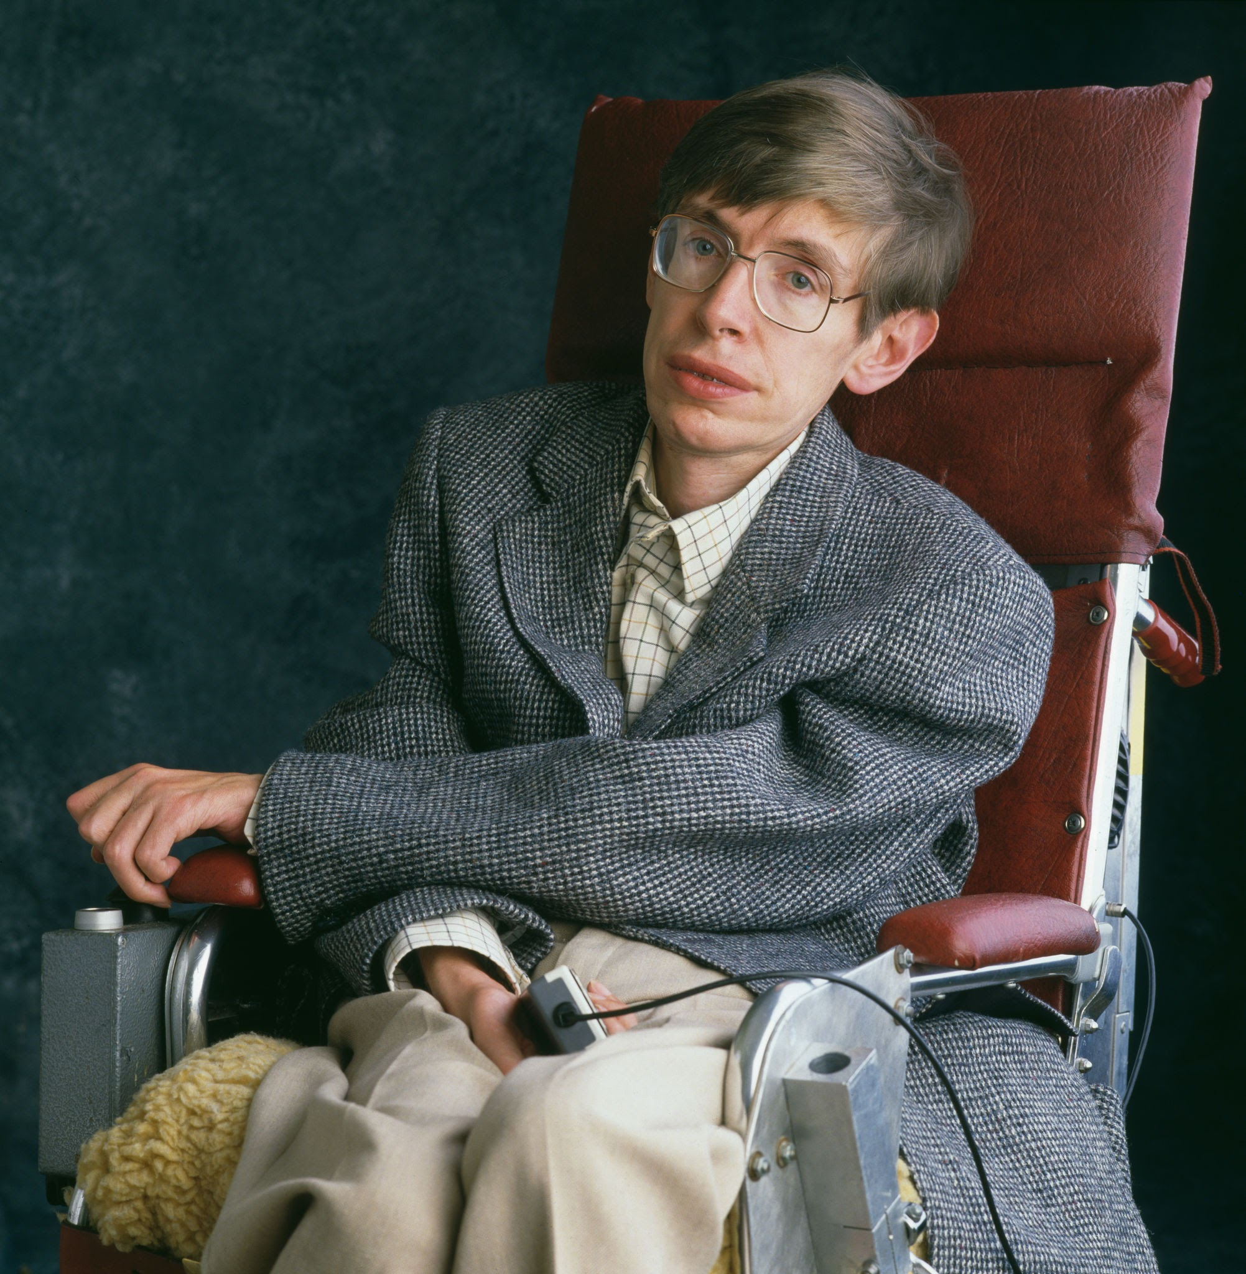

Slide 3
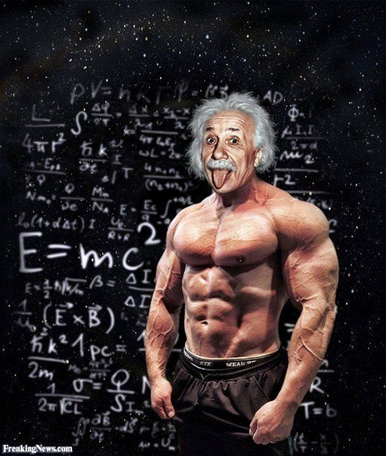

Slide 4
PHYSICAL STRENGTH IS NOT REQUIRED FOR IQ DEVELOPMENT

Slide 5
PHYSICAL SILENCE OR PEACE IS REQUIRED FOR IQ DEVELOPMENT

Slide 6
PHYSICAL FITNESS IS NOT NEEDED FOR COGNITIVE DEVELOPMENT

Slide 7
PHYSICAL FITNESS IS NOT NEEDED FOR LEARNING

Slide 8
LEARNING IS PRIMARILY A SENSORY PROCESS

Slide 9
LEARNING IS NOT A MOTOR PROCESS

Slide 10
MOTOR PROCESSES ARE NOT NEEDED FOR SENSORY DEVELOPMENT

Slide 11
SPENDING TIME ON MOTOR EXERCISES WILL BE AT COST OF TIME GIVEN FOR SENSORY EXERCISES WHEN THE GOAL IS TO GENERATE SENSORY DEVELOPMENT.

Slide 12
CEREBRAL PALSY IS A MOTOR DEFICIT MOTOR EXERCISES ARE MUST IN CEREBRAL PALSY

Slide 13
AUTISM IS NOT CEREBRAL PALSY, IT IS A SENSORY VARIANT OF STATIC ONE TIME SENSORY INSULT MANIFESTING AS SENSORY DEFICIT.

Slide 14
SENSORY EXERCISES SHALL BE THE CRUX OF SENSORY DEVELOPMENT.

Slide 15
SENSORY EXERCISES SHALL BE MAINSTAY OF DEVELOPING SENSES, HELPING THE SENSORY DEVELOPMENT IN AUTISM.

Slide 16
AUTISM IS A CENTRAL SENSE DEFICIT

Slide 17
CENTRAL MOTOR DEFICIT HAS NO NON-SENSE BEHAVIOUR

Slide 18
REAL SENSORY DEVELOPMENT IS OF SENSE OF LEARNING

Slide 19
LEARNING IS A SENSORY PROCESS.

Slide 20
LEARNING IS REQUIRED FOR DEVELOPMENT OF SENSE

Slide 21
LEARNING IS A PROCESS OF SENSE PERCEPTION, SENSE PROCESSION, SENSE COGNITION

Slide 22
CENTRAL SENSORY DEVELOPMENT IS MORE IMPPORTANT FOR DEVELOPMENT OF CENTRAL SENSE

Slide 23
90% OF SENSE IS DEVELOPED BY EYE AND EAR

Slide 24
PERIPHERAL SENSORY ORGANS HAVE LEAST ROLE IN COGNITION, COMPARED TO EYES AND EARS, THE HEAD SENSES

Slide 25
WORKING ON PHYSICAL EXERCISES INSTEAD OF SENSORY EXERCISES IS LIKE TREATING CP AND NOT AUTISM

Slide 26
WORKING ON PHYSICAL EXERCISES FOR SENSORY NEEDS IS WASTE OF TIME.

Slide 27
SENSORY NEEDS DOESN’T MEAN CHILD NEEDS IT, IT SHOULD MEAN THAN SPECIFIC SENSE IS NOT HELPING IN LEARNING

Slide 28
WHAT IS AFFECTED SHALL BE THE GOAL, SO CENTRAL SENSORY DEVELOPMENT SHALL BE THE GOAL

Slide 29
REAL SENSORY DEVELOPMENT IS DEVELOPING THE COMMON SENSE

Slide 30
COMMON SENSE IS A REFLECTION OF LEARNING THROUGH EYES AND EARS

Slide 31
LEARNING BY EYES IS PASSIVE, GLORIFYING A CHILD AS VISUAL LEARNER TAKES HIM AWAY FROM AUDITORY LEARNING.

Slide 32
AUDITORY LEARNING GIVES MUCH MORE QUALITY LEARNING THAN EYES.

Slide 33
VISION HAS LIMITS OF LEARNING READ LANGUAGE OR HEARING IS LIMITLESS KNOWLEDGE

Slide 34
LEARNING NEEDS A POSTURE OF ATTENTION

Slide 35
POSTURE OF ATTENTION FOR LEARNING

Slide 38
POSTURE OF SIT, LOOK AND LISTEN.. TO LEARN #MAKINGSENSE

Slide 39
TO LEARN SENSIBLY, PHYSICAL STABILITY AND NOT PHYSICAL STRENGTH IS NEEDED

Slide 40
STRENGTH IS NOT NEEDED FOR STABILITY

Slide 41
SUSTAINED SITTING IS NEEDED FOR FOCUSSING WITH EYES AND EARS

Slide 42
UNLESS U SIT WITHOUT DISTRACTIONS, U CANT FOCUS WITH EYES

Slide 43
FOCUS WITH EYES IS NOT EYE CONTACT

Slide 44
FOCUS WITH EYES IS NEEDED IN THE FORM OF SUSTAINED EYE TO EYE CONNECTION

Slide 45
EYE CONTACT IS WITH NONLIVING OBJECTS WITH LIVING PEOPLE ITS AN EYE TO EYE CONNECTION

Slide 46
NO CONNECTION, NO COMMUNICATION, NO CONVERSATION

Slide 47
UNLESS U FOCUS SUSTAINED WITH EYES, YOU CANNOT LEND AN EAR

Slide 48
ONE WHO CANNOT SIT AND LOOK AT YOU, CANNOT DEVELOP SUSTAINED LISTENING.

Slide 49
ITS OUR JOB TO HELP EVERY CHILD SIT LOOK LISTEN… THE DEVELOPMENT OF FIRST 8 MONTHS OF LIFE

Slide 50
ACTUALLY WE ARE HELPING CHILD LEARN BY SITTING, LOOKING, LISTENING.

Slide 51
MAKING AN AUTISM KID, HELP SIT, LOOK, LISTEN IN SUSTAINED WAY WILL HELP THE CHILD LEARN

Slide 52
HELPING LEARN, HELPS SHAPING FUTURE.

Slide 53
SO IF OUR GOAL IS TO LEARN, WE SHALL PRIORITISE ALL EFFORTS ON POSTURE OF LEARNING AND NOT RANDOM THERAPIES.

Slide 54
THIS IS THE PRINCIPLE OF GOAL DIRECTED COGNITIVE APPROACH.

Slide 55
IF WE ARE NOT PRIORITISING THE GOALS, WE ARE WASTING TIME.

Slide 56
OUR FIRST GOAL IS TO MAKE THE CHILD PHYSICALLY STABLE, THAT IS SIT

Slide 57
IF YOU NEED THE CHILD TO LEARN SITTING, AVOID GIVING EXERCISES / ACTIVITIES AND THERAPIES THAT INVOLVE NON SITTING ACTIVITIES.

Slide 58
IF WE NEED CHILD TO FOCUS WITH EYES FOR SOCIAL LEARNING, USE EYES FOR EYE TO EYE CONNECTION, NOT FOR DISTRACTIONS OR NON LIVING CONNECTIONS.

Slide 59
LOOK AT THE CHILD, WHEN U KNOW CHILD IS LOOKING AT U , U FEEL NOW CHILD IS READY TO LISTEN.

Slide 60
WHEN U FEEL GOD IS LOOKING AT U, U END UP PRAYING TO GOD FEELING AS IF GOD IS LISTENING

Slide 61
IF OUR NEED IS TO CONNECT WITH HUMANS WITH EYES, GIVE EYE TO EYE LEARNING. TO CONNECT, TO FEEL, TO EMOTE AND TO TOUCH THE HEART.. BEGNING OF NONVERBAL COMMUNICATION.

Slide 62
LIVING TO LIVING LEARNING IS MORE INFORMATIVE BY NONLIVING TO LIVING LEARNING. SIT WITH A HUMAN FACE TO FACE FOR SOCIAL BEHAVIORAL LEARNING. SO AVOID SCREEN BASED LEARNING.

Slide 63
WHEN U FEEL CHILD NEEDS TO COMMUNICATE MORE, TALK MORE, CHILD SHOULD LISTEN MORE.

Slide 64
SUSTAINED LISTENING, SUSTAINED ATTENTION, SUSTAINED LEARNING

Slide 65
IF OUR GOAL IS TO FILL UP THE LANGUAGE DEFICIT, USE THE AUDITORY ATTENTION FOR LANGUAGE BASED LEARNING

Slide 66
MUSIC DOESN’T HELP IN UNDERSTANDING LANGAUGE.

Slide 67
SANGIT DOLNE KE LIYE , BHASHA BOLNE KE LIYE

Slide 68
CONCLUSIONS

Slide 69
AUTISM REVERSAL PRINCIPLES

Slide 70
PART 2 DEVELOPMENT OF COMMUNICATION PART 3 DEVELOPMENT OF EGO, PERSONALITY, BEHAVIOUR PART 4 DEVELOPMENT OF SYNTAX, COMPOSITION, STORIES PART 5 SCIENCE AND MATHS

